Slide 1
Social Engineering
An attack vector most intricate to handle!

Slide 2
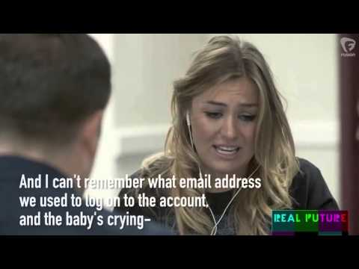
What is 'Social Engineering'?
"…the art and science of getting people to comply with your wishes."
-Harl, 'People Hacking'

Slide 3
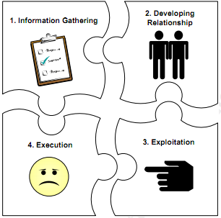
The Social Engineering Cycle

Slide 4

1. Information gathering
There could be variety of techniques which is used by the aggressor to gather sensitive information about the target(s). Once these information are gathered, it can be used to build a relationship either with the target or someone who is important to the success of the attack.
Information that might be gathered includes, but is not only limited to:
A birth date
A phone list
An organization’s organizational chart

Slide 5
2. Developing Relationship
An aggressor will first try to build up a good bonding with the target. They make sure that they gain the trust of the target which they’ll later exploit.
3. Exploitation
The target could then be manipulated by the ‘trusted’ attacker to reveal their sensitive information like password to carry out an action (eg. re-enter your username pass for reversing Facebook policies) this normally occurs. This action could be at the beginning or end of the attack of the next phase.
4.Execution
Once the target has finished the task requested by the attacker, the cycle is complete.

Slide 6
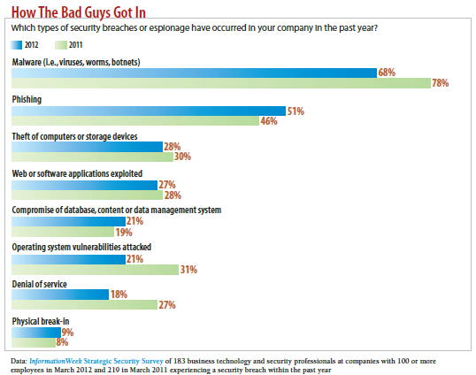
General Attack vector Facts and figures

Slide 7
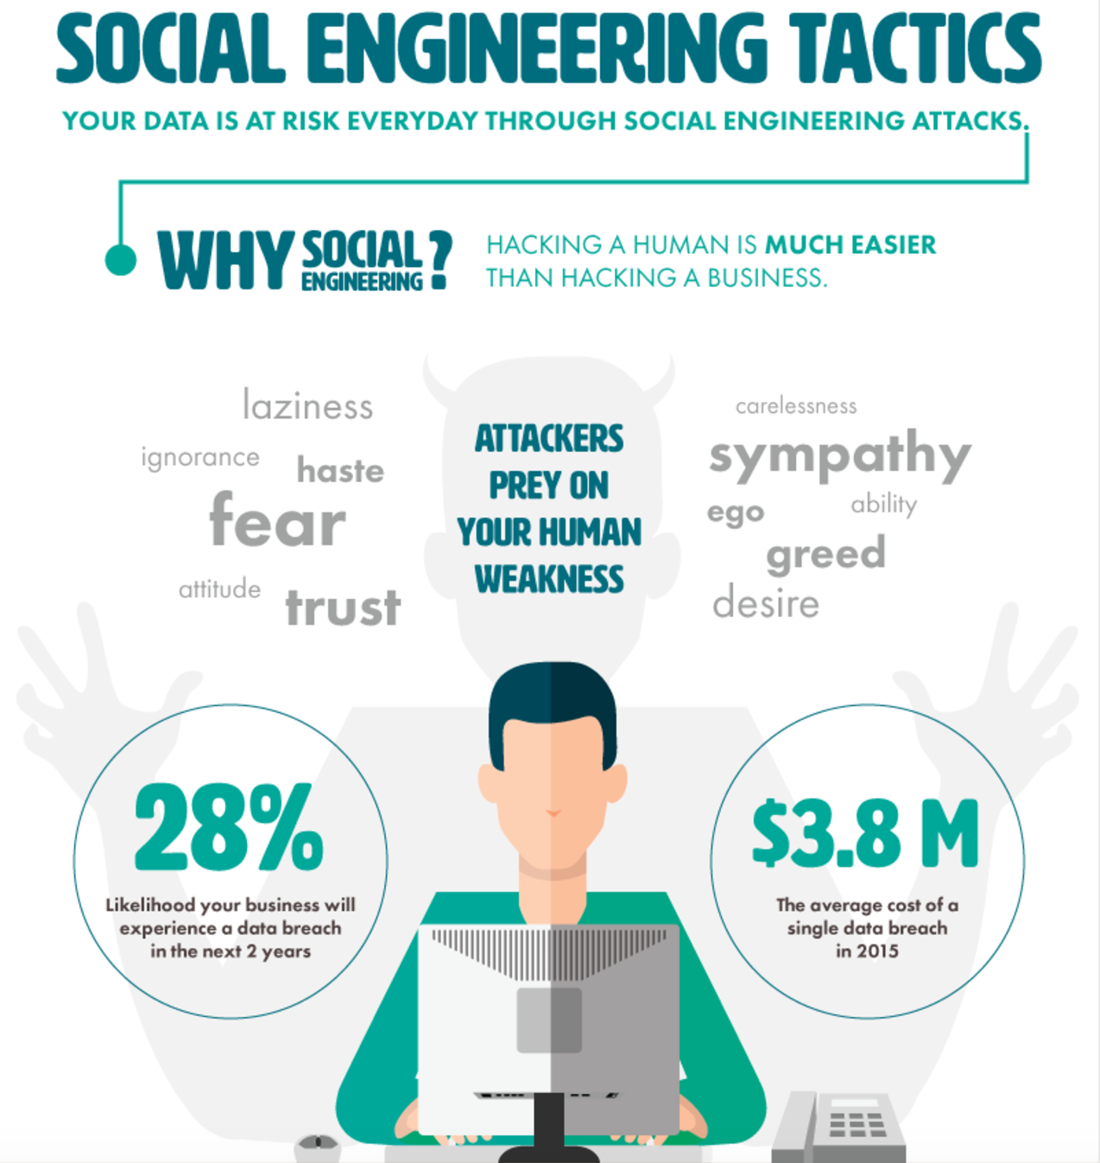

Slide 8
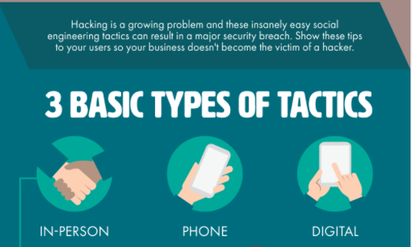

Slide 9
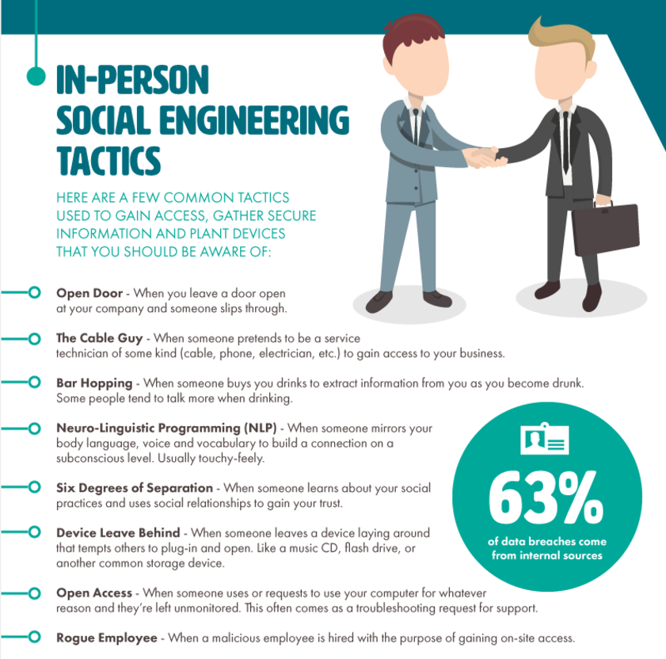
Notes:
http://www.smartfile.com/blog/social-engineering-attacks/

Slide 10
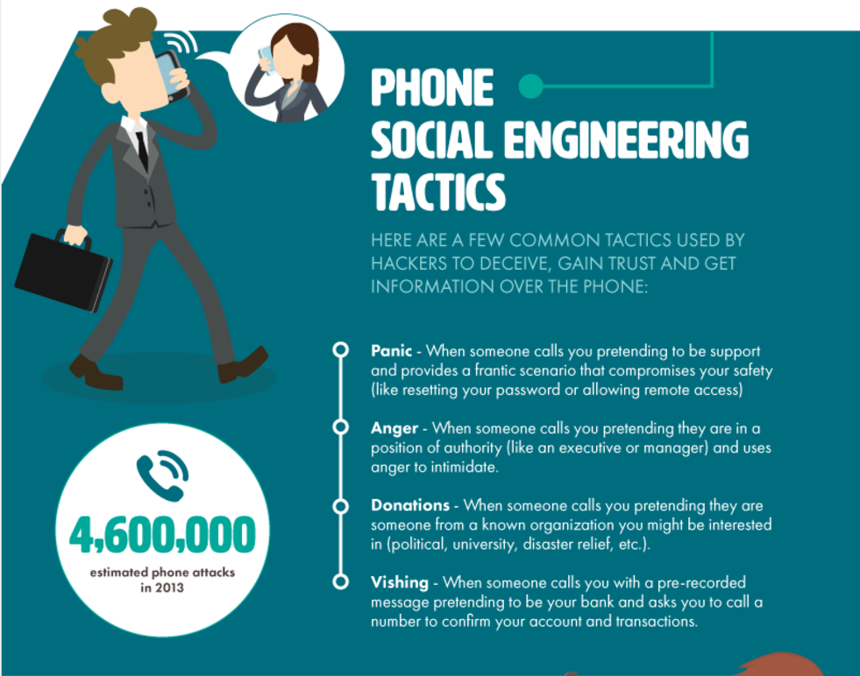
Notes:
Aggressive and threatening phone calls by criminals impersonating IRS agents remain a major threat to taxpayers. Beware of new ‘can you hear me’ phone scam
It may not seem like a big deal at the time, but it’s what the criminals can do later with that recording that’s dangerous to you, your information and your identity.
Once they have a recording on file of your voice saying ‘yes,’ scammers can then use it to authorize unwanted charges on bills, credit cards and more.
‘You say ‘yes,’ it gets recorded and they say that you have agreed to something,’ Susan Grant, director of consumer protection for the Consumer Federation of America, told CBS News.

Slide 11
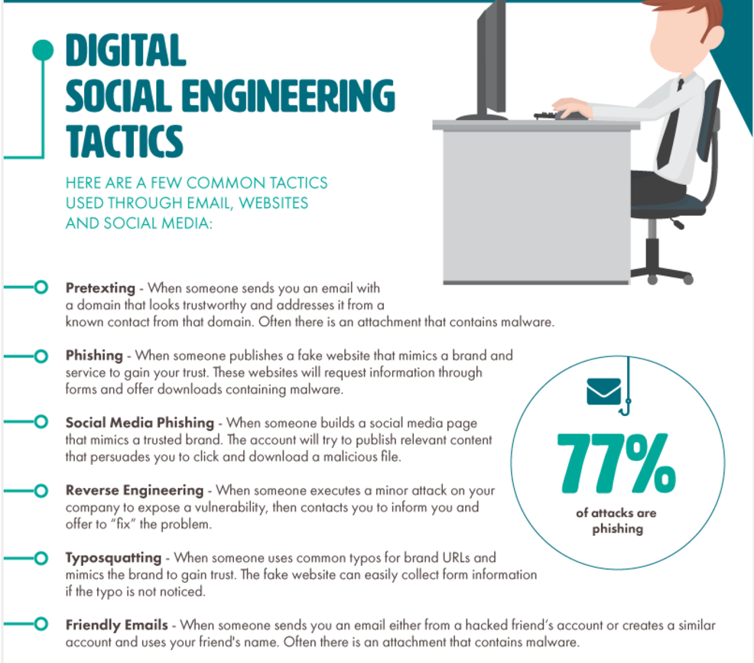
Notes:
Phising- Somebody makes a fake website to sell play stations and games for us. You see the advertisement and are already tempted by its low prices and products. You browse to that website which asks you to login and create an account before you purchase or browse something. Once you enter your details all your information is with them.
Reverse Engineering- The WannaCry ransomware attack was a worldwide cyberattack by the WannaCry^{[a]} ransomware cryptoworm, which targeted computers running the Microsoft Windows operating system by encrypting data and demanding ransom payments in the Bitcoin cryptocurrency.^{[9]}
The attack began on Friday, 12 May 2017,^{[10]} and within a day was reported to have infected more than 230,000 computers in over 150 countries.^{[11][12]} Parts of Britain's National Health Service (NHS), Spain's Telefónica, FedEx and Deutsche Bahn were hit, along with many other countries and companies worldwide.

Slide 12
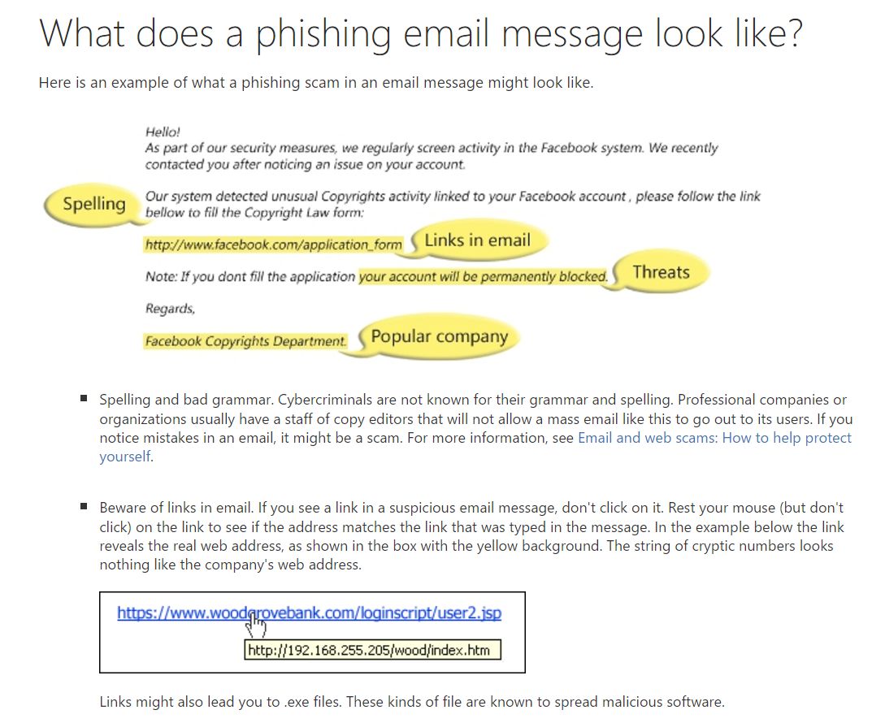
Notes:
Pretexting is defined as the practice of presenting oneself as someone else in order to obtain private information. It is more than just creating a lie, in some cases it can be creating a whole new identity and then using that identity to manipulate the receipt of information. Pretexting can also be used to impersonate people in certain jobs and roles that they never themselves have done.

Slide 13
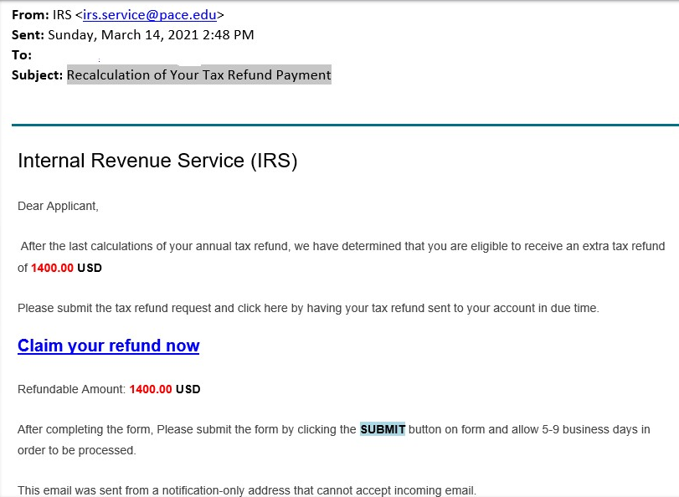
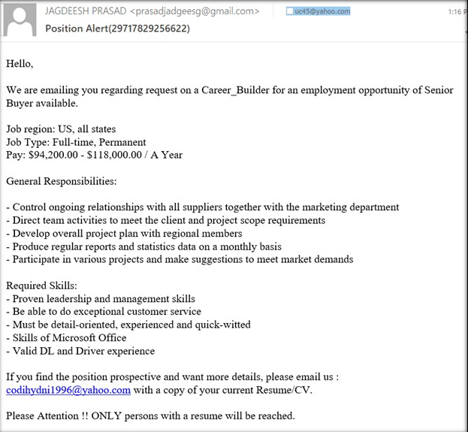
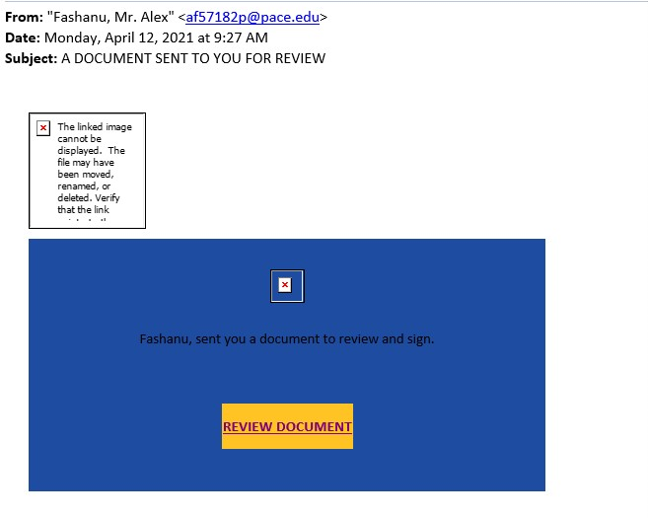
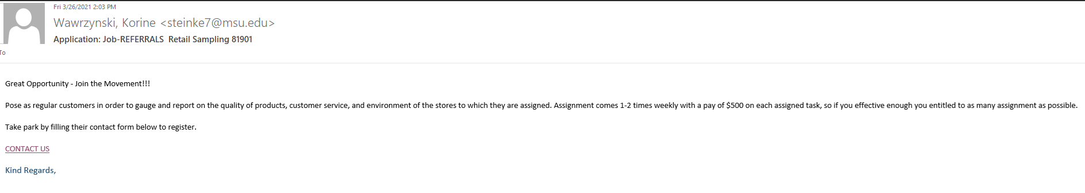

Slide 14


Countermeasures to prevent
Social Engineering
DON’T CLICK THE LINK
Check the Domain on Your Phone and Desktop
Type the site name in your browser (such as www.paypal.com)
Never send sensitive account information by e-mail
Account numbers, SSN, passwords
Verify any person who contacts you (phone or email).
If someone calls you on a sensitive topic, thank them, hang up and call them back using a number that you know is correct, like from your credit card or statement.
Look for the SSL (the lock icon next to the URL) on Desktop and Mobile
When Using Social Media, Limit Surveys and Games

Slide 15
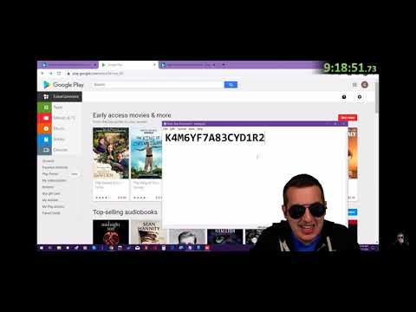
In Practice: What happens when you actually pick up one of those “extend your car warranty” calls:
Notes:
Full Video: https://www.youtube.com/watch?v=sRMMwpDTs5k&t=4063s

